Slide 1

Notes:
Chapter 16 Project oversight
Chapter 16 is centered at project oversight and governance at a corporate level. It will begin with project management trends and the importance of project oversight, and then focuses on the functions of project portfolio management and the phase gating methodology for project process control.

Slide 2
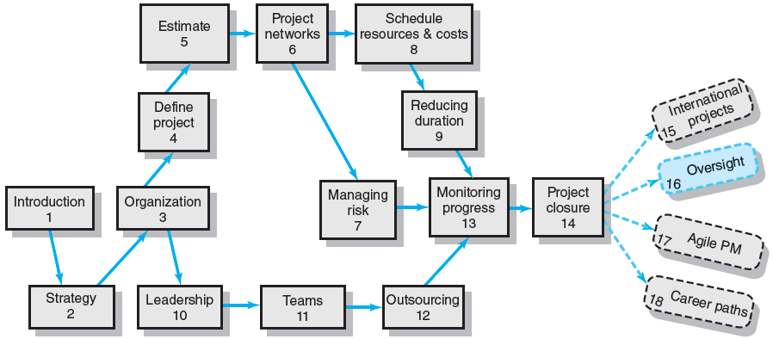
Where We Are Now
Notes:
Where Are We Now?
After the project implementation and closure stages covered in chapters 13 and 14, this chapter goes beyond project management, to focus on project portfolio management at the corporate level. Project portfolio management takes an integrated approach to optimally coordinating corporate-wide project resources, not only to achieve the organization’s short-term operational needs, but also realizing its strategic visions and goals.

Slide 3
Current and Future Trends in Project Management
Forces for Change
Global competition, knowledge explosion, innovation, time to market, and shortened product life cycles
Two Major Outcomes for the 21st Century:
An increase in the scope of project management and system integration.
The focus of projects has shifted from tactical to strategic.
An increasing discipline in the way projects are managed.
Notes:
Trends in project management
Current and future trends that represent forces for change that increase the need for and importance of the oversight functions of project management are global competition, knowledge explosion, innovation, time to market, and shortened product life cycles. As a result, the two major trends in project management in the 21st century are:
An increase in the scope of project management and systems integration as the focus of projects has shifted from tactical to strategic, and
An increasing need for more internal discipline in the ways that projects are managed.

Slide 4
Project Oversight
Project Oversight
A set of principles and processes to guide and improve the management of projects.
Oversight’s Purposes:
To ensure projects meet the organizational needs for standards, procedures, accountability, efficient allocation of resources, and continuous improvement in the management of projects.
To support the project manager.
Notes:
Project Oversight
Project oversight is embodied in a set of principles and processes intended to guide and improve the management of projects. Its purposes are to ensure projects meet the organizational needs for standards, procedures, accountability, efficient allocation of resources, and continuous improvement in the management of projects and to support the project manager.

Slide 5
Importance of Oversight to the Project Manager
Oversight Functions:
Providing support and help to the project manager where needed.
Determining the environment in which the project manager will implement his or her project.
Influence the performance measures used to hold the project manager responsible and accountable.
Providing the oversight group to which the project manager will reporting at predetermined phases in the project.
Notes:
Importance of Oversight to the Project Manager
Oversight functions are important to project managers because they:
Provide support and help to the project manager where needed.
Determine the environment in which the project manager will implement his or her project.
Influence the performance measures used to hold the project manager responsible and accountable.
Provide the oversight group to which the project manager will be reporting at predetermined phases in the project.

Slide 6
Oversight Activities
At the Organization Level
Project selection.
Portfolio management.
Improving how all projects are managed over time.
Assessing and elevating the maturity level of the organization’s project management system.
Using balanced scorecard approach to review progress on strategic priorities.
At the Project Level
Review projects’ objectives.
Decide on issues raised by the project manager.
Track and assist the project to resolve bottlenecks.
Review status reports from the project manager.
Audit and review lessons learned.
Authorize major deviations from the original scope.
Cancel the project.
Notes:
Oversight Activities
Typical activities of project oversight cover two dimensions: organization and project.
Oversight activities at the organization level include
Project selection.
Portfolio management.
Improving how all projects are managed over time.
Assessing and elevating the maturity level of the organization’s project management system.
Using balanced scorecard approach to review progress on strategic priorities.
Oversight activities at the project level include:
Reviewing projects’ objectives.
Deciding on issues raised by the project manager.
Tracking and assisting the project to resolve bottlenecks.
Reviewing status reports from the project manager.
Auditing and reviewing lessons learned.
Authorizing major deviations from the original scope.
Cancelling the project.

Slide 7
Increasing Scope of Project Management and System Integration
Portfolio Project Management
The centralized management of projects to ensure that the allocation of resources to projects is directed toward projects that contribute the greatest value to organization goals.
Project Office (PO)
The unit responsible for continued support of consistent application of selection criteria, standards, and processes; training of and general assistance to project managers; and continued improvement and use of best practices.
Notes:
Project Portfolio Management and Project Office
Portfolio management is becoming more common and important to project organizations, especially among high-performing companies.
Project portfolio management centralizes the management of all projects to ensure that the allocation of resources to projects is directed toward projects that contribute the greatest value to organization goals.
Project Office (PO) is an organization unit responsible for continued support of consistent application of selection criteria, standards, and processes; training of and general assistance to project managers; and continued improvement and use of best practices.

Slide 8
Key Responsibilities of Project Portfolio Management
Senior executive oversight committee
Reviews project options available by type (new, operational, compliance)
Confirms business case and linkage to organizational strategy
Selects, prioritizes, and balances the overall risk of all organizational projects
Ensures availability of resources and competencies
Sets macro time, cost, and requirements
Reviews gating outcomes
Notes:
Project Portfolio Management Functions
Key responsibilities of the project portfolio management office and/or the senior executive oversight committee for managing the organization’s project portfolio include:
Reviewing project options available by type (new, operational, compliance)
Confirming business case and linkage to organizational strategy
Selecting, prioritizing, and balancing the overall risk of all organizational projects
Ensuring availability of resources and competencies
Setting macro time, cost, and requirements
Reviewing gating outcomes

Slide 9
Benefits of the Activities of the Project Office
Project Office (PO)
Support integration of project portfolios for the use of best practices in strategic planning and control.
Serve as a bridge between senior management and project managers within the social/cultural environment of the organization.
Support integration of project management processes from selection through project closure and lessons learned.
Provide training that supports the movement of the organization to a higher level of project management maturity.
Notes:
Benefits of the Project (Portfolio) Office
Benefits of the project office (PO) include:
Support integration of project portfolios for the use of best practices in strategic planning and control.
Serve as a bridge between senior management and project managers within the social/cultural environment of the organization.
Support integration of project management processes from selection through project closure and lessons learned.
Provide training that supports the movement of the organization to a higher level of project management maturity.

Slide 10
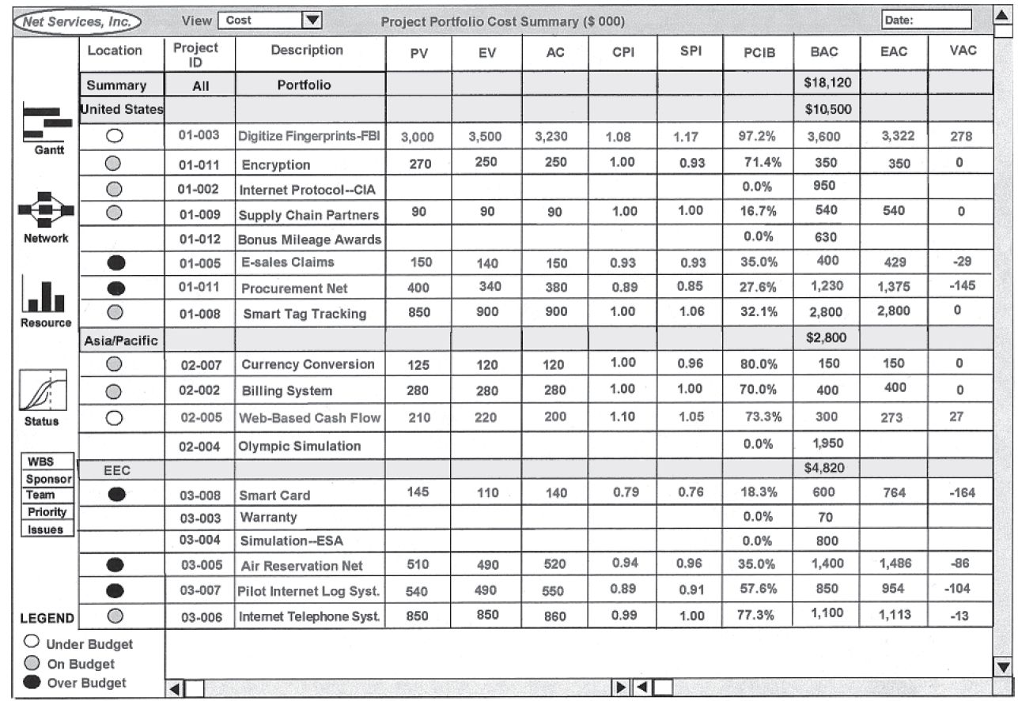
Project Portfolio Cost Summary Report for Top Management
FIGURE 16.1
Notes:
Project Portfolio Cost Summary Report
Figure 16.1 depicts a project portfolio cost summary report (in a spreadsheet row and column format) that was developed for use by the top management of an international organization. It summarizes each project’s ID, location, description, planned value, earned value, actual cost, performance indices, percentage of completion, baseline budget, and the cost projection at completion.

Slide 11
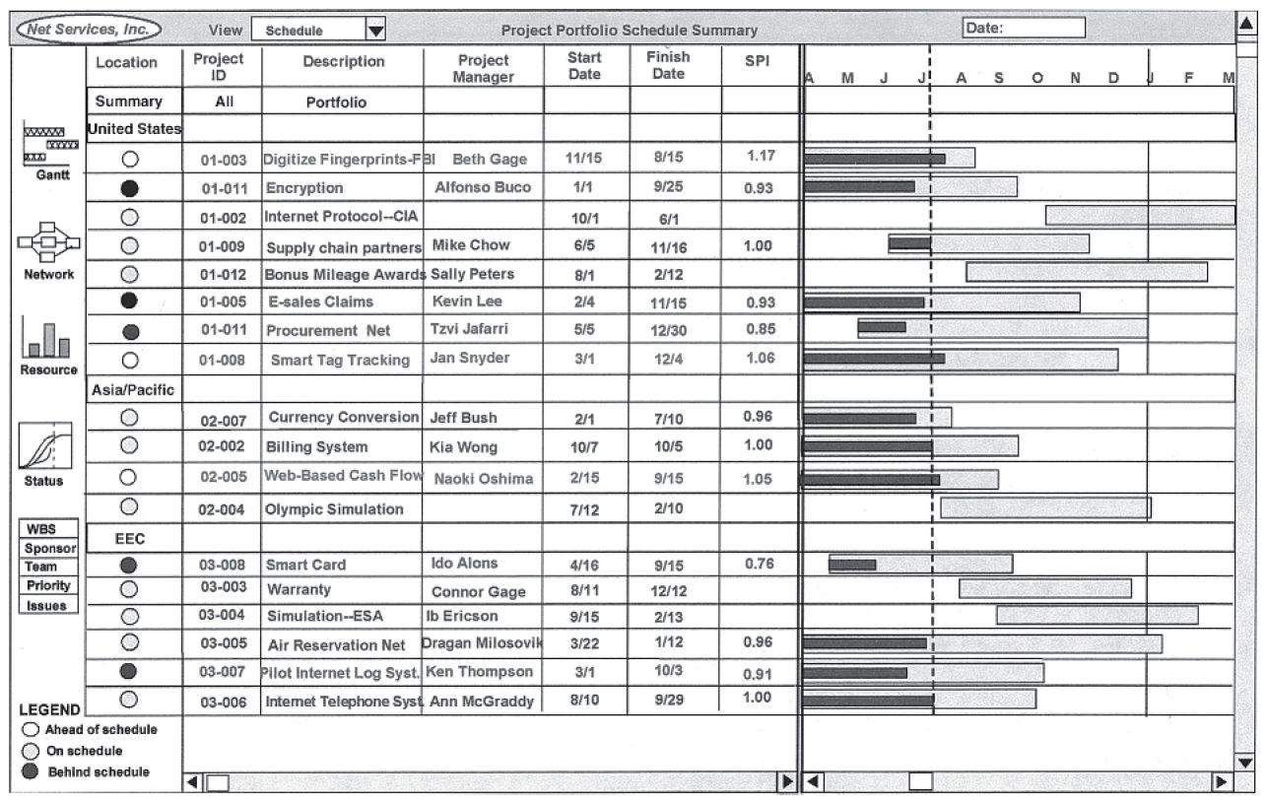
Project Portfolio Schedule Summary Report for Project Schedules
FIGURE 16.2
Notes:
Project Portfolio Schedule Summary Report
Figure 16.2 presents a portfolio summary report for project schedules. It summarizes each project’s ID, location, project description, start date, finish date, and schedule performance with a tracking Gantt chart. Ideally the system should allow the user to “drill down” from the summary report to view more project details such as WBS, resources, and issues.

Slide 12
Phase Gate Methodology
Phase Gate Review Process
A structured process to review, evaluate, and document outcomes in each project phase and to provide management with information to guide resource deployment toward strategic goals.
Decision Gate Components
Required deliverables
Gate criteria and specific outputs
A clear yes/no decision on whether to go ahead.
Notes:
Phase Gate methodology
The phase gate methodology is a structured oversight process to review, evaluate, and document outcomes in each project phase at consistent points (“gates”) and to provide management with information to guide resource deployment toward strategic goals.
Phase gating provides a larger perspective to managing multiple projects in a project portfolio. Gatekeepers first focus on organization needs, and then secondly individual project needs. When the priorities of the organization change, a project whether it is executing on time, on budget, and meeting the project goals may have to be “killed.”
The minimum components required of a decision gate are:
Required deliverables (e.g., a product design or prototype).
Gate criteria and specific outcomes (e.g., adjusting project scope, or schedule).
A clear yes/no decision on whether to go ahead.

Slide 13
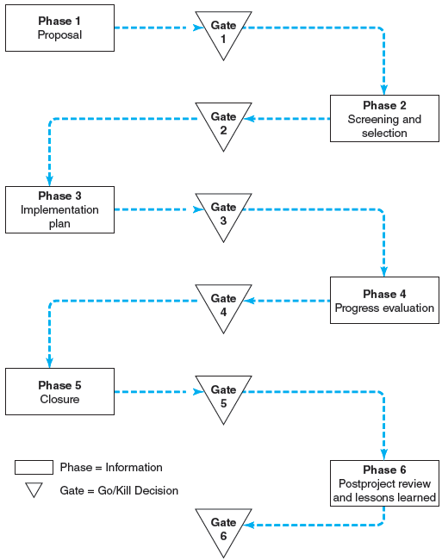
Abridged Generic Phase Gate Process Diagram
FIGURE 16.3
Notes:
A generic phase gate process diagram
Figure 16.3 is a flow diagram of an abridged, generic variation of phase gate methodology that has application across all types of projects. Another practice used during the implementation phase is to create gates at significant milestones. The decision gates focus on go/kill decisions based on major questions such as those listed for Gate 1, which asks:
Is the project really a good idea?
What business problem does the proposed project solve?
Does this project align with our strategic direction?
What type of project is this? Strategic, organization maintenance, “must,” etc.?
Should the project be considered?

Slide 14
Benefits of Using Phase Gating
Phase Gating
Provides excellent training for functional staff who serve on oversight review groups.
Encourages a larger perspective and role of projects within the organization.
Is a clear-cut process, easily understood, and applicable to all projects in a portfolio.
Provides a structured process for a project office to follow on all projects.
Eliminates poor value projects.
Supports faster decision making with predefined deliverables for each gate.
Notes:
Benefits of using phase gating
Major benefits of using phase gating as an oversight function are:
Provides excellent training for functional staff who serve on an oversight review group.
Encourages a larger perspective and role of projects within the organization.
Is a clear-cut process, easily understood, and applicable to all projects in the portfolio.
Provides a structured process for a project office to follow on all projects.
Eliminates projects of poor value
Supports faster decision making with predefined deliverables for each gate.

Slide 15
Organization’s Project Management Maturity Model
Capability Maturity Model (CMM)
Focuses on guiding and assessing organizations in implementing concrete best practices of managing software development projects.
Organizational Project Management Maturity Model (OPM3)
Is divided into a continuum of growth levels: initial, repeatable, defined, managed, and optimized.
Notes:
Project Management Capacity
Two oversight models may be considered for gauging project management capability of an organization. They are:
The Capability Maturity Model (CMM), which focuses on guiding and assessing organizations in implementing the best practices of managing software (product) development projects.
The Organizational Project Maturity Model (OPM3), which is divided into a continuum of growth levels: initial, repeatable, defined, managed, and optimized. Currently, the Project Management Institute (PMI) supports a version of the Organizational Project Management Maturity Model.
The purposes of all maturity models (there exist many) are to enable organizations to assess their progress in implementing the best practices in their industry and continuously move to improvement. It is important to understand that the model does not ensure success; it serves only as a measuring stick and an indicator of progress.

Slide 16
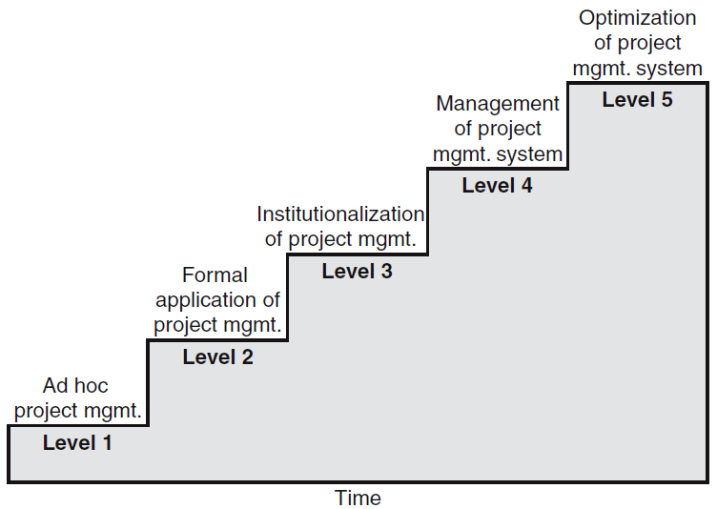
Project Management Maturity Model
FIGURE 16.2
Notes:
Organization’s Project Management Maturity Model
Figure 16.4 presents the textbook authors’ version of the project management maturity model. The latest version is called OPM3 (See www.pmi.org/opm3). Typically, these project management maturity models are divided into a continuum of growth layers: initial, repeatable, defined, managed, and optimized.
Level 1 is called ad hoc project management, when no consistent project management process is in place.
Level 2 has a formal application of project management, when the organization applies established project management procedures and techniques.
Level 3 institutionalizes project management, when an organization-wide project management system is established, tailored to specific needs of the organization with flexibility to adapt the process to unique characteristics of the project.
Level 4 makes use of a corporate wide project management system, when the organization develops a system for managing multiple projects that are aligned with strategic goals of the organization.
Level 5 focuses on optimizing the project management system, when the organization focuses on continuous improvement through incremental advancements of existing practices and by innovations using new technologies and methods.

Slide 17
The Balanced Scorecard Model
Balanced Scorecard Model
Assumes that people will take the necessary actions to improve the performance of the organization on the given measures and goals.
Reviews projects over a longer horizon—5 to 10 years after the project is implemented than other models.
Has a more “macro” perspective than project selection models.
Measures performance results for four major areas of activities—customer, internal, innovation and learning, and financial.
Notes:
The balanced scorecard model
The Balanced Scorecard has been popularly applied to organizations’ performance management at the corporate and division levels. By applying the balanced scorecard concept to project management,
It assumes that managers will take to improve their performance that are aligned with organization’s strategic vision and goals.
It assesses the performance of the project portfolio management (office) over a long horizon - 5 to 10 years.
It takes a “macro” perspective toward project (portfolio) management.
It measures the performance from four perspectives, which are financial, customer base, internal process, and innovation and learning.

Slide 18
Key Terms
Balance scorecard
Oversight
Phase gating
Portfolio management
Project management maturity
Project office (PO)
Notes:
Key terms
Summarized below are some key terminology covered in this chapter, including balanced scorecard, project oversight, phase gating, portfolio management, and project office.
Balanced scorecard method is a model that measures the long-run results of major program activities in four areas—customer, internal, innovation and learning, and financial.
Oversight is a set of principles and processes to guide and improve the management of projects to ensure projects meet the needs of the organization through standards, procedures, accountability, efficient allocation of resources, and continuous improvement in the management of projects.
Phase gating is a structured process to review, evaluate, and document outcomes at each project phase and to provide management with information to guide resource deployment toward strategic goals.
Portfolio management is the centralized selection and management of a portfolio of projects to ensure that allocation of resources is directed and balanced toward the strategic focus of the organization.
Project management is the application of knowledge, skills, tools, and techniques to project activities to meet the project requirements
Project office (PO) is a centralized unit within an organization or department that oversees and improves the management of projects.

